Slide 1
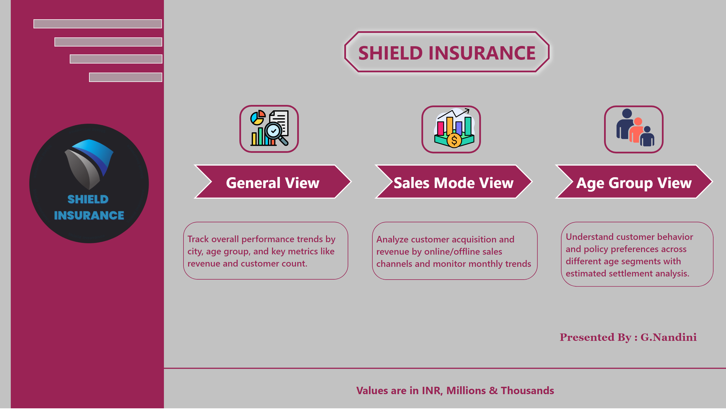
Home
Notes:
lineChart
No alt text provided
actionButton
No alt text provided
shape
No alt text provided
textbox
No alt text provided
slicer
No alt text provided
slicer
No alt text provided
slicer
No alt text provided
slicer
No alt text provided
slicer
No alt text provided
shape
No alt text provided
image
No alt text provided
general Image
No alt text provided
age Image
No alt text provided
sales image
No alt text provided
box selection border
No alt text provided
actionButton
No alt text provided
lineChart
No alt text provided
textbox
No alt text provided
image
No alt text provided
shape
No alt text provided
shape
No alt text provided
box selection border
No alt text provided
box selection border
No alt text provided
shape
No alt text provided
textbox
No alt text provided
textbox
No alt text provided
shape
No alt text provided
shape
No alt text provided
shape
No alt text provided
shape
No alt text provided
shape
No alt text provided
shape
No alt text provided
shape
No alt text provided
shape
No alt text provided

Slide 2
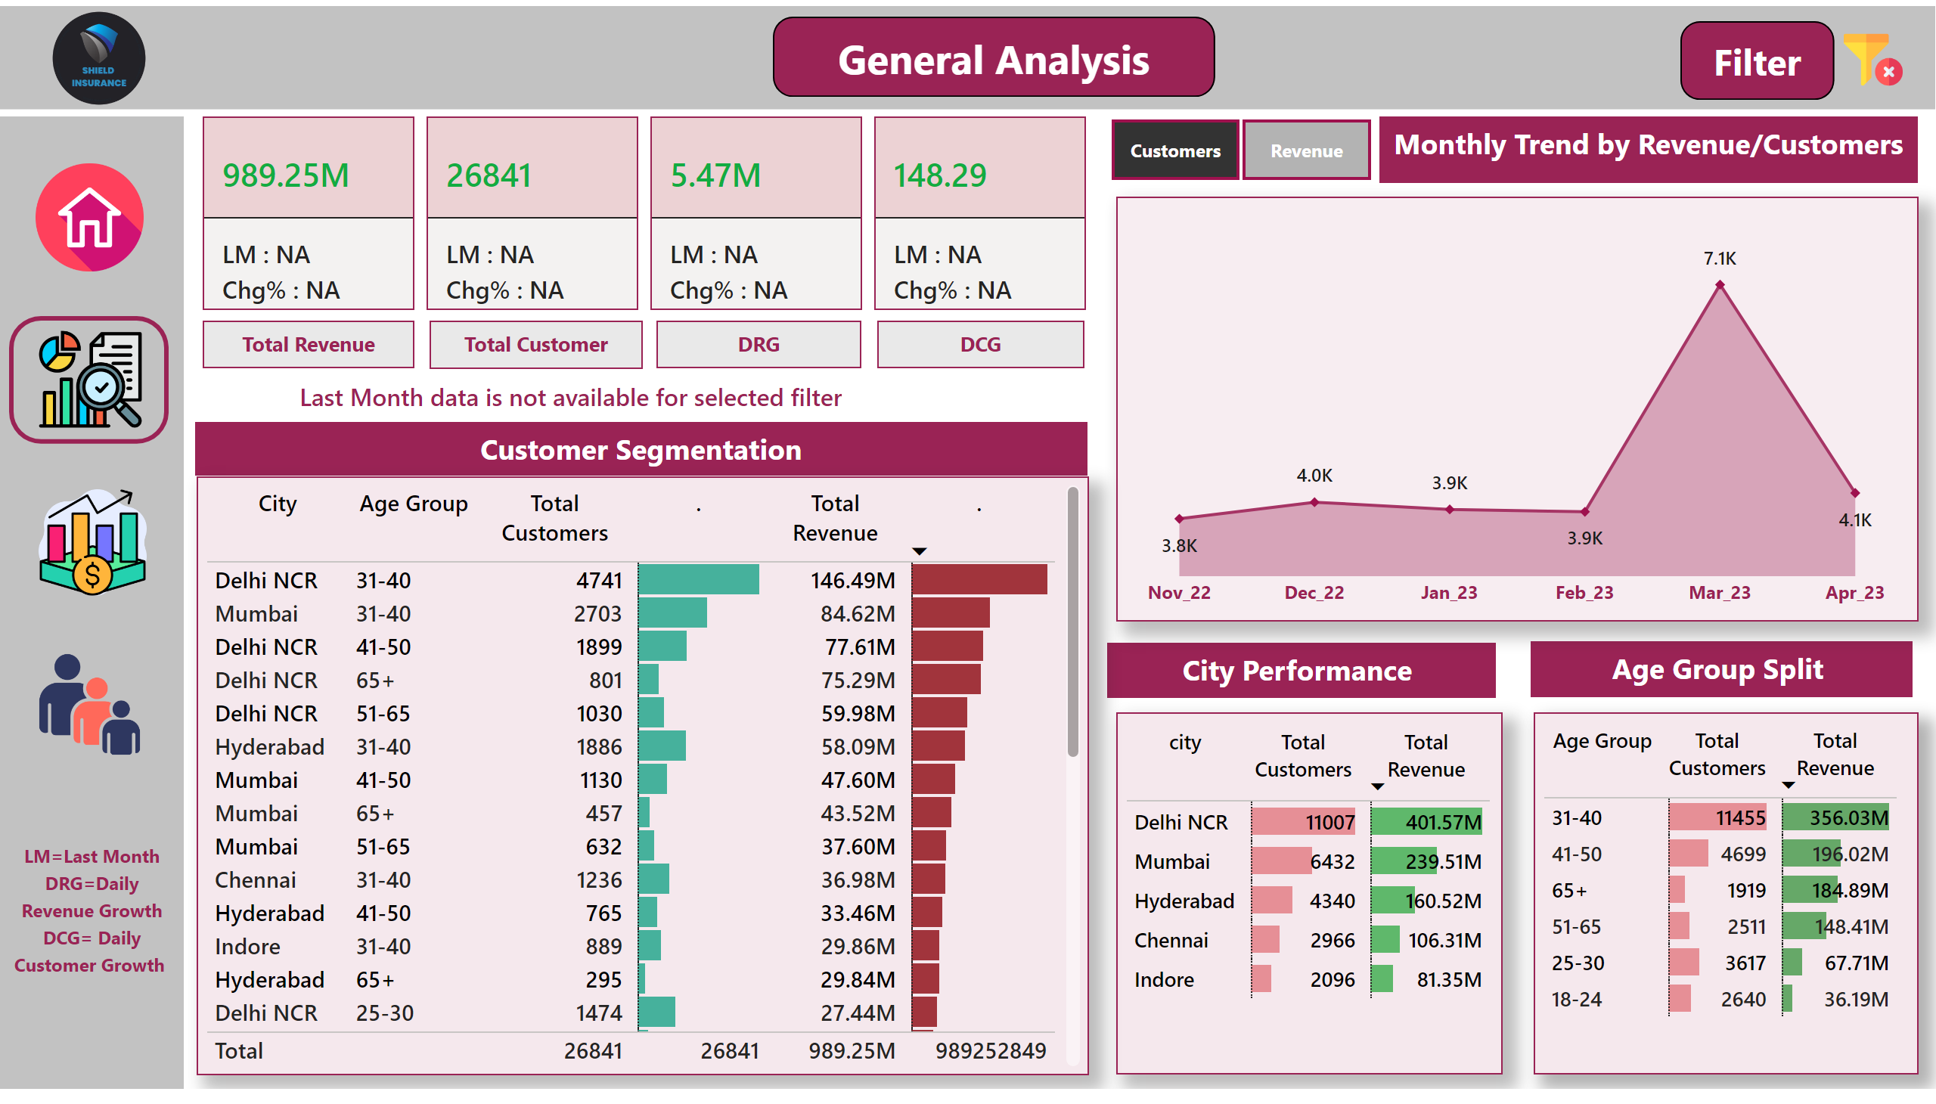
General View
Notes:
shape
No alt text provided
shape
No alt text provided
shape
No alt text provided
image
No alt text provided
general Image
No alt text provided
age Image
No alt text provided
sales image
No alt text provided
box selection border
No alt text provided
home
No alt text provided
tableEx
No alt text provided
tableEx
No alt text provided
tableEx
No alt text provided
filter Shape
No alt text provided
textbox
No alt text provided
slicer
No alt text provided
slicer
No alt text provided
slicer
No alt text provided
slicer
No alt text provided
slicer
No alt text provided
slicer image
No alt text provided
textbox
No alt text provided
textbox
No alt text provided
textbox
No alt text provided
Text box shortcut
No alt text provided
Monthly Trend by Revenue/Customers
No alt text provided
slicer
No alt text provided
image
No alt text provided
textbox
No alt text provided
textbox
No alt text provided
textbox
No alt text provided
Revenue
No alt text provided
textbox
No alt text provided
Customers
No alt text provided
DRG
No alt text provided
textbox
No alt text provided
DCG
No alt text provided
shape
No alt text provided

Slide 3
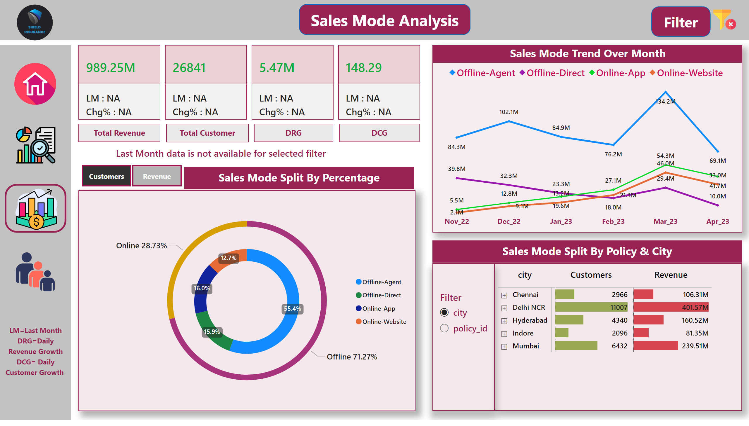
Sales View
Notes:
lineChart
No alt text provided
actionButton
No alt text provided
shape
No alt text provided
textbox
No alt text provided
slicer
No alt text provided
slicer
No alt text provided
slicer
No alt text provided
slicer
No alt text provided
slicer
No alt text provided
shape
No alt text provided
shape
No alt text provided
slicer image
No alt text provided
image
No alt text provided
general Image
No alt text provided
age Image
No alt text provided
sales image
No alt text provided
box selection border
No alt text provided
home
No alt text provided
Policy/City vs Sales Mode
No alt text provided
Sales Mode Split By Percentage
No alt text provided
actionButton
No alt text provided
lineChart
No alt text provided
Sales Mode Trend Over Month
No alt text provided
filter Shape
No alt text provided
Text box shortcut
No alt text provided
textbox
No alt text provided
donutChart
No alt text provided
image
No alt text provided
slicer
No alt text provided
textbox
No alt text provided
textbox
No alt text provided
slicer
No alt text provided
textbox
No alt text provided
Revenue
No alt text provided
Customers
No alt text provided
DRG
No alt text provided
DCG
No alt text provided
textbox
No alt text provided
textbox
No alt text provided
textbox
No alt text provided
textbox
No alt text provided
shape
No alt text provided

Slide 4
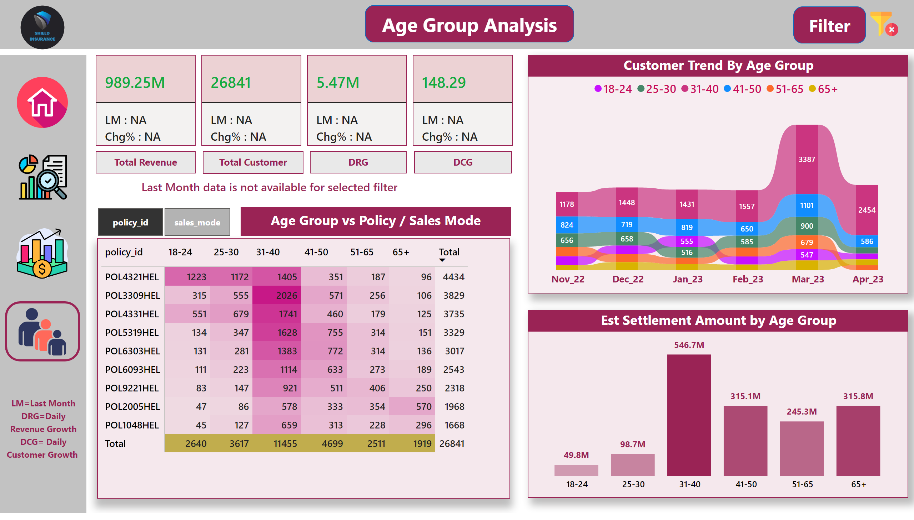
Age Group View
Notes:
lineChart
No alt text provided
actionButton
No alt text provided
shape
No alt text provided
textbox
No alt text provided
slicer
No alt text provided
slicer
No alt text provided
slicer
No alt text provided
slicer
No alt text provided
slicer
No alt text provided
shape
No alt text provided
shape
No alt text provided
slicer image
No alt text provided
image
No alt text provided
general Image
No alt text provided
age Image
No alt text provided
sales image
No alt text provided
box selection border
No alt text provided
home
No alt text provided
actionButton
No alt text provided
lineChart
No alt text provided
filter Shape
No alt text provided
Text box shortcut
No alt text provided
textbox
No alt text provided
image
No alt text provided
Policy vs Age Group
No alt text provided
Customer Trend By Age Group
No alt text provided
Est Settlement Amount by Age Group
No alt text provided
slicer
No alt text provided
textbox
No alt text provided
Revenue
No alt text provided
Customers
No alt text provided
DRG
No alt text provided
DCG
No alt text provided
textbox
No alt text provided
textbox
No alt text provided
textbox
No alt text provided
textbox
No alt text provided
shape
No alt text provided

